Slide 1
Guide to Programming with Python
Chapter Seven
Files and Exceptions: The Trivia Challenge Game

Slide 2
Objectives
Read from text files
Write to text files
Read and write more complex data with files
Intercept and handle errors during a program’s execution
Guide to Programming with Python

Slide 3
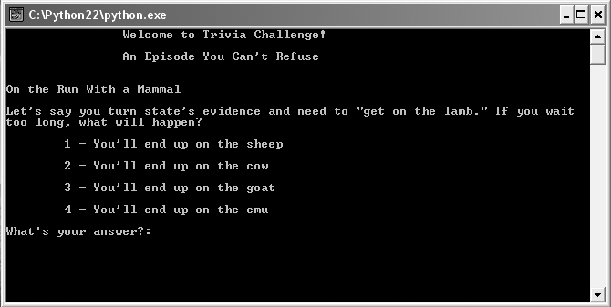
Trivia Challenge Game
Figure 7.1: Sample run of the Trivia Challenge game
Four inviting choices are presented, but only one is correct.
Guide to Programming with Python

Slide 4
Reading from Text Files
Plain text file: File made up of only ASCII characters
Easy to read strings from plain text files
Text files good choice for simple information
  Easy to edit
  Cross-platform
Guide to Programming with Python

Slide 5
The Read It Program
File read_it.txt contains
Line 1
This is line 2
That makes this line 3
Guide to Programming with Python

Slide 6
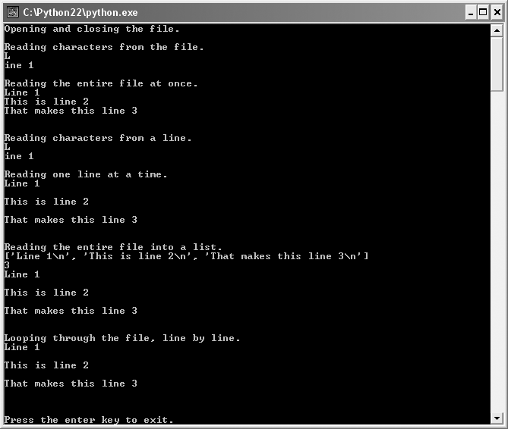
The Read It Program (continued)
Figure 7.2: Sample run of the Read It program
The file is read using a few different techniques.
Guide to Programming with Python

Slide 7
Opening and Closing a Text File
text_file = open("read_it.txt", "r")
Must open before read (or write)
open() function
  Must pass string filename as first argument, can include path info
  Pass access mode as second argument
  Returns file object
"r" opens file for reading
Can open a file for reading, writing, or both
Guide to Programming with Python

Slide 8
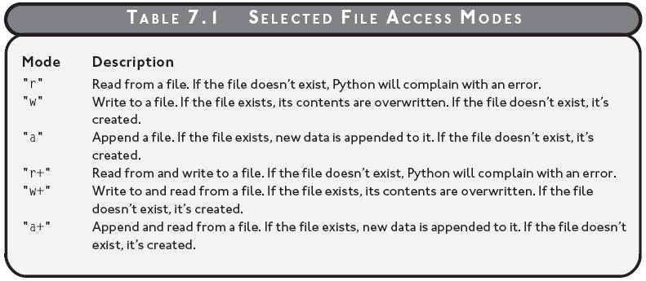
Opening and Closing a Text File (continued)
Table 7.1: Selected File Access Modes
Files can be opened for reading, writing, or both.
Guide to Programming with Python

Slide 9
Opening and Closing a Text File (continued)
text_file.close()
close() file object method closes file
Always close file when done reading or writing
Closed file can't be read from or written to until opened again
Guide to Programming with Python

Slide 10
Reading Characters from a Text File
>>> print text_file.read(1)
L
>>> print text_file.read(5)
ine 1
read() file object method
  Allows reading a specified number of characters
  Accepts number of characters to be read
  Returns string
Each read() begins where the last ended
End of a file, read() returns empty string
Guide to Programming with Python

Slide 11
Reading Characters from a Text File (continued)
>>> whole_thing = text_file.read()
>>> print whole_thing
Line 1
This is line 2
That makes this line 3
read() returns entire text file as a single string if no argument passed
Guide to Programming with Python

Slide 12
Reading Characters from a Line
>>> text_file = open("read_it.txt", "r")
>>> print text_file.readline(1)
L
>>> print text_file.readline(5)
ine 1
readline() file object method
  Reads from current line
  Accepts number characters to read from current line
  Returns characters as a string
Guide to Programming with Python

Slide 13
Reading Characters from a Line (continued)
>>> text_file = open("read_it.txt", "r")
>>> print text_file.readline()
Line 1
>>> print text_file.readline()
This is line 2
>>> print text_file.readline()
That makes this line 3
readline() file object method
  Returns the entire line if no value passed
  Once read all of the characters of a line, next line becomes current line
Guide to Programming with Python

Slide 14
Reading All Lines into a List
>>> text_file = open("read_it.txt", "r")
>>> lines = text_file.readlines()
>>> print lines
['Line 1\n', 'This is line 2\n', 'That makes this line 3\n']
readlines() file object method
  Reads text file into a list
  Returns list of strings
  Each line of file becomes a string element in list
Guide to Programming with Python

Slide 15
Looping through a Text File
>>> text_file = open("read_it.txt", "r")
>>> for line in text_file:
print line
Line 1
This is line 2
That makes this line 3
Can iterate over open text file, one line at a time
Technique available beginning in Python 2.2
Guide to Programming with Python

Slide 16
Writing to a Text File
Easy to write to text files
Two basic ways to write
Guide to Programming with Python

Slide 17
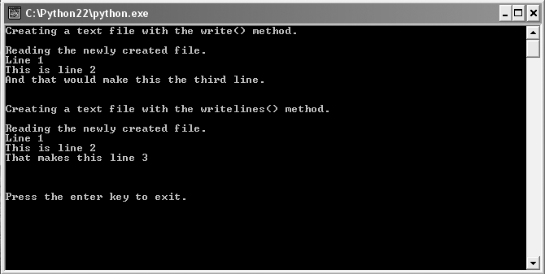
The Write It Program
Figure 7.3: Sample run of the Write It program
File created twice, each time with different file object method.
Guide to Programming with Python

Slide 18
Writing Strings to a Text File
text_file = open("write_it.txt", "w")
text_file.write("Line 1\n")
text_file.write("This is line 2\n")
text_file.write("That makes this line 3\n")
write() file object method writes new characters to file open for writing
Guide to Programming with Python

Slide 19
Writing a List of Strings to a Text File
text_file = open("write_it.txt", "w")
lines = ["Line 1\n", "This is line 2\n", "That makes this line 3\n"]
text_file.writelines(lines)
writelines() file object method
  Works with a list of strings
  Writes list of strings to a file
Guide to Programming with Python

Slide 20
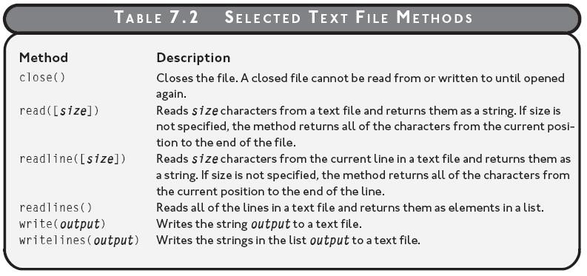
Selected Text File Methods
Table 7.2: Selected text file methods
Guide to Programming with Python

Slide 21
Storing Complex Data in Files
Text files are convenient, but they’re limited to series of characters
There are methods of storing more complex data (even objects like lists or dictionaries) in files
Can even store simple database of values in a single file
Guide to Programming with Python

Slide 22
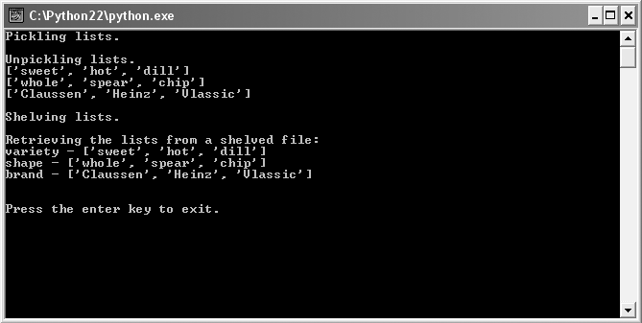
The Pickle It Program
Figure 7.4: Sample run of the Pickle It program
Each list is written to and read from a file in its entirety.
Guide to Programming with Python

Slide 23
Pickling Data and Writing it to a File
>>> import cPickle
>>> variety = ["sweet", "hot", "dill"]
>>> pickle_file = open("pickles1.dat", "w")
>>> cPickle.dump(variety, pickle_file)
Pickling: Storing complex objects in files
cPickle module to pickle and store more complex data in a file
cPickle.dump() function
  Pickles and writes objects sequentially to file
  Takes two arguments: object to pickle then write and file object to write to
Guide to Programming with Python

Slide 24
Pickling Data and Writing it to a File (continued)
Can pickle a variety of objects, including:
  Numbers
  Strings
  Tuples
  Lists
  Dictionaries
Guide to Programming with Python

Slide 25
Reading Data from a File and Unpickling It
>>> pickle_file = open("pickles1.dat", "r")
>>> variety = cPickle.load(pickle_file)
>>> print variety
["sweet", "hot", "dill"]
cPickle.load() function
  Reads and unpickles objects sequentially from file
  Takes one argument: the file from which to load the next pickled object
Guide to Programming with Python

Slide 26
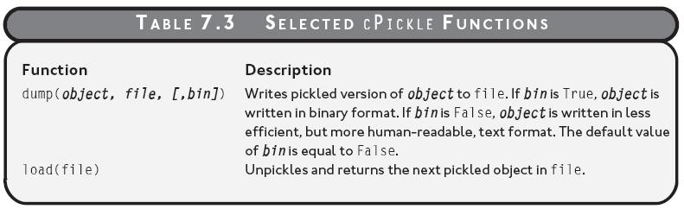
Selected cPickle Functions
Table 7.3: Selected cPickle functions
Guide to Programming with Python

Slide 27
Using a Shelf to Store Pickled Data
>>> import shelve
>>> pickles = shelve.open("pickles2.dat")
shelf: An object written to a file that acts like a dictionary, providing random access to a group of objects
shelve module has functions to store and randomly access pickled objects
shelve.open() function
  Works a lot like the file object open() function
  Works with a file that stores pickled objects, not characters
  First argument: a filename
  Second argument: access mode (default value is "c“)
Guide to Programming with Python

Slide 28
Using a Shelf to Store Pickled Data (continued)
>>> pickles["variety"] = ["sweet", "hot", "dill"]
>>> pickles.sync()
"variety" paired with ["sweet", "hot", "dill"]
sync() shelf method forces changes to be written to file
Guide to Programming with Python

Slide 29
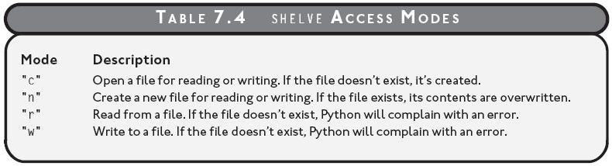
Shelve Access Modes
Table 7.4: Shelve access modes
Guide to Programming with Python

Slide 30
Using a Shelf to Retrieve Pickled Data
>>> print for key in pickles.keys()
... print key, "-", pickles[key]
"variety" - ["sweet", "hot", "dill"]
Shelf acts like a dictionary
  Can retrieve pickled objects through key
  Has keys() method
Guide to Programming with Python

Slide 31
Handling Exceptions
>>> 1/0
Traceback (most recent call last):
File "<pyshell#0>", line 1, in -toplevel-
1/0
ZeroDivisionError: integer division or modulo by zero
Exception: An error that occurs during the execution of a program
Exception is raised and can be caught (or trapped) then handled
Unhandled, halts program and error message displayed
Guide to Programming with Python

Slide 32
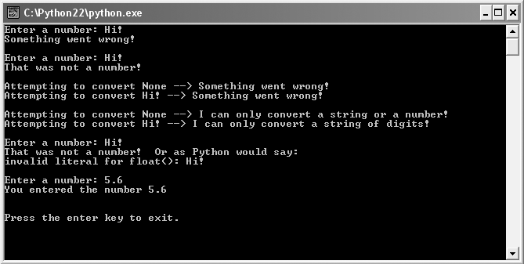
The Handle It Program
Figure 7.5: Sample run of the Handle It program
Program doesn’t halt when exceptions are raised.
Guide to Programming with Python

Slide 33
Using a try Statement with an except Clause
try:
num = float(raw_input("Enter a number: "))
except:
print "Something went wrong!"
try statement sections off code that could raise exception
Instead of raising exception, except block run
If no exception raised, except block skipped
Guide to Programming with Python

Slide 34
Specifying an Exception Type
try:
num = float(raw_input("\nEnter a number: "))
except(ValueError):
print "That was not a number!“
Different types of errors raise different types of exceptions
except clause can specify exception types to handle
Attempt to convert "Hi!" to float raises ValueError exception
Good programming practice to specify exception types to handle each individual case
Avoid general, catch-all exception handling
Guide to Programming with Python

Slide 35
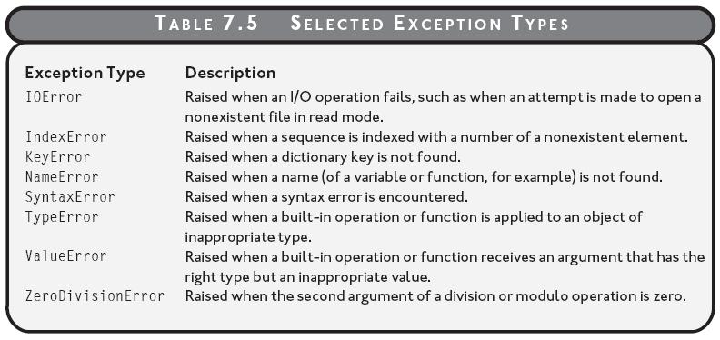
Selected Exception Types
Table 7.5: Selected exception types
Guide to Programming with Python

Slide 36
Handling Multiple Exception Types
for value in (None, "Hi!"):
try:
print "Attempting to convert", value, "–>",
print float(value)
except(TypeError, ValueError):
print "Something went wrong!“
Can trap for multiple exception types
Can list different exception types in a single except clause
Code will catch either TypeError or ValueError exceptions
Guide to Programming with Python

Slide 37
Handling Multiple Exception Types (continued)
for value in (None, "Hi!"):
try:
print "Attempting to convert", value, "–>",
print float(value)
except(TypeError):
print "Can only convert string or number!"
except(ValueError):
print "Can only convert a string of digits!“
Another method to trap for multiple exception types is multiple except clauses after single try
Each except clause can offer specific code for each individual exception type
Guide to Programming with Python

Slide 38
Getting an Exception’s Argument
try:
num = float(raw_input("\nEnter a number: "))
except(ValueError), e:
print "Not a number! Or as Python would say\n", e
Exception may have an argument, usually message describing exception
Get argument if it lists a variable before the colon in except statement
Guide to Programming with Python

Slide 39
Adding an else Clause
try:
num = float(raw_input("\nEnter a number: "))
except(ValueError):
print "That was not a number!"
else:
print "You entered the number", num
Can add single else clause after all except clauses
else block executes only if no exception is raised
num printed only if assignment statement in the try block raises no exception
Guide to Programming with Python

Slide 40
Trivia Challenge Data File Layout
<category>
<question>
<answer 1>
<answer 2>
<answer 3>
<answer 4>
<correct answer>
<explanation>
Guide to Programming with Python

Slide 41
Trivia Challenge Partial Data File
An Episode You Can't Refuse
On the Run With a Mammal
Let's say you turn state's evidence and need to "get on the lamb." If you wait /too long, what will happen?
You'll end up on the sheep
You'll end up on the cow
You'll end up on the goat
You'll end up on the emu
1
Guide to Programming with Python

Slide 42
Summary
The open() function opens a file and returns a file object
The close() file object method closes a file
The read() file object method allows reading a specified number of characters from a text file, which are returned as a string
The readline() file object method reads a specified number of characters from the current line of a text file, which are returned as a string
The readlines() file object method reads a text file and returns list of strings where each element is a line from the file
Guide to Programming with Python

Slide 43
Summary (continued)
The write() file object method writes new characters to a file
The writelines() file object method writes a list of strings to a file
Pickling is storing complex objects in files
The cPickle.dump() function pickles and writes objects sequentially to a file
The cPickle.load() function reads and unpickles objects sequentially from file
A shelf is an object written to a file that acts like a dictionary, providing random access to a group of objects
Guide to Programming with Python

Slide 44
Summary (continued)
The shelve.open() function opens a file with pickled objects
An exception is an error that occurs during the execution of a program
A try statement sections off code that could raise an exception and provides code to be run in case of exception
An exception may have an argument which is usually a message describing the exception
After all except clauses within a try block, you can add a single else clause with a block that executes if no exception is raised
Guide to Programming with Python

